Slide 1
Managerial Accounting and Cost Concepts: ACME Laboratories Ltd.
Cost-Volume-Profit Relationships and Financial Insights
Presented to : Md. Erfan
Presented by: Sakil Ahmed Saon
Date: October 2024

Slide 2

Introduction
Overview of ACME Laboratories Ltd.
Established in 1954, a leader in pharmaceutical manufacturing
Mission: Ensure health, vigor, and happiness

Slide 3

Objectives of ACME Laboratories Ltd.
• Market leadership and growth
• Product development and innovation
• Social responsibility and sustainability

Slide 4

Managerial Accounting Practices
• Costing methods: Activity-Based Costing (ABC)
• Budgeting and forecasting for R&D, marketing, production
• Key performance indicators (KPIs) to track efficiency

Slide 5

Significance of ACME’s Managerial Accounting
• Insight into Bangladesh's pharmaceutical industry
• ACME's international market presence
• Application of CVP (Cost-Volume-Profit) analysis

Slide 6
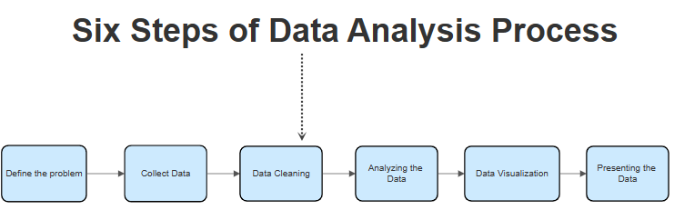
Methodology for Managerial Accounting at ACME
• Data collection from annual reports and benchmarks
• Analyzing variable and fixed costs
• Contribution margin and CVP analysis

Slide 7
ACME Laboratories Ltd. Organization Profile
• Founded in 1954
• Over 800 medicines across therapeutic categories
• International presence and ethical focus

Slide 8
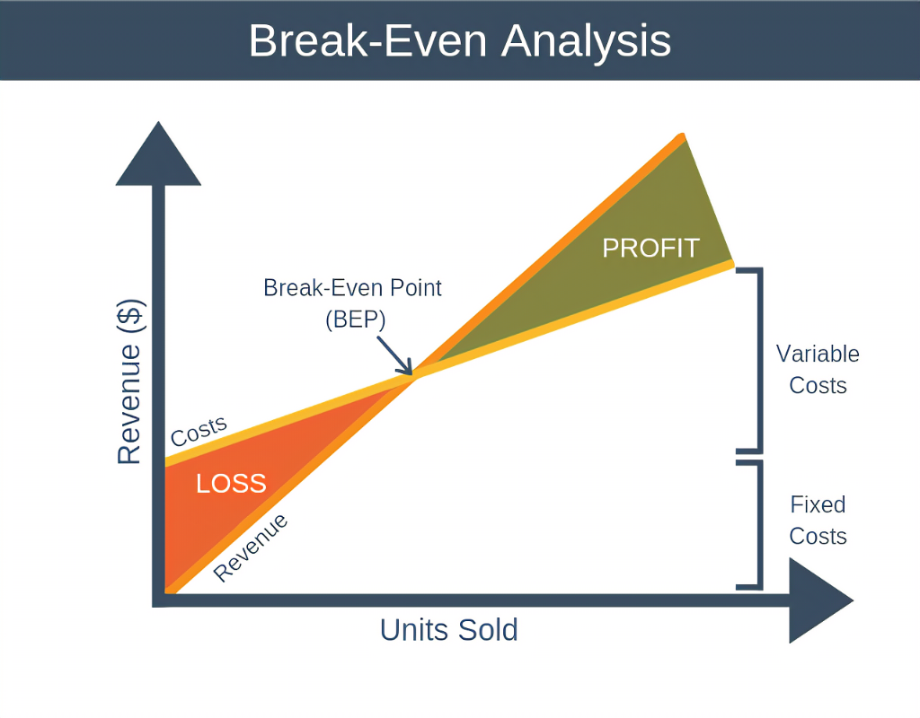
Cost-Volume-Profit (CVP) Analysis
• Break-even point calculation
• Impact of sales volume, costs, and profitability
• Critical assumptions in CVP analysis

Slide 9
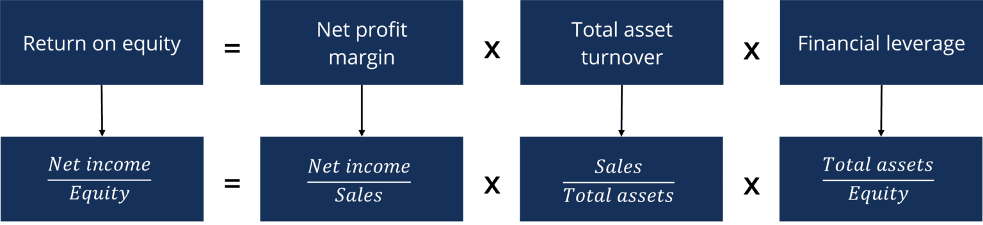
Key Insights from ACME’s Financial Statements
• Revenue breakdown
• Contribution margin and fixed expenses
• Profitability at different sales volumes

Slide 10
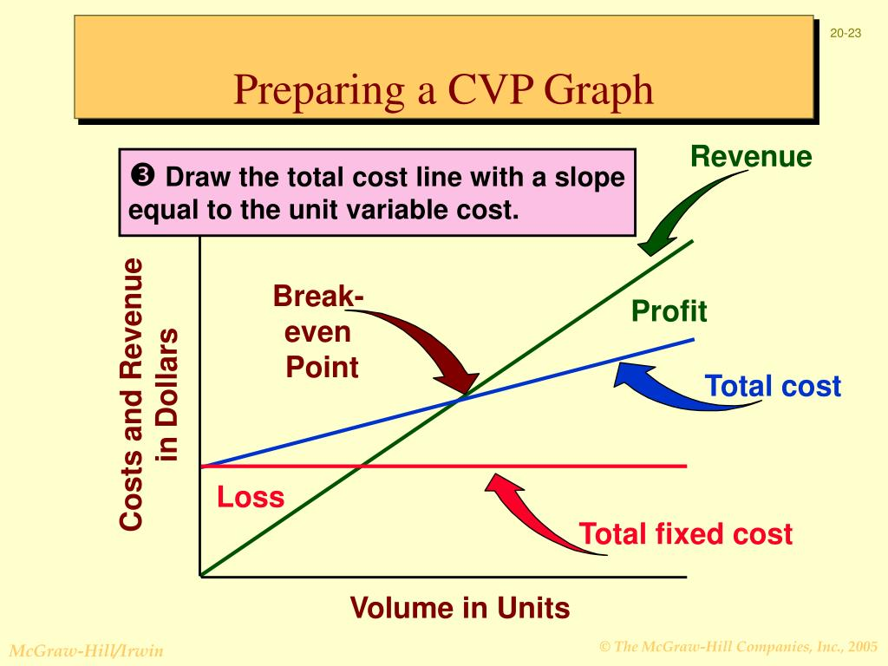
Graphical CVP Representation
• Visual breakdown of sales, costs, and profits
• Breakeven point and margin of safety

Slide 11
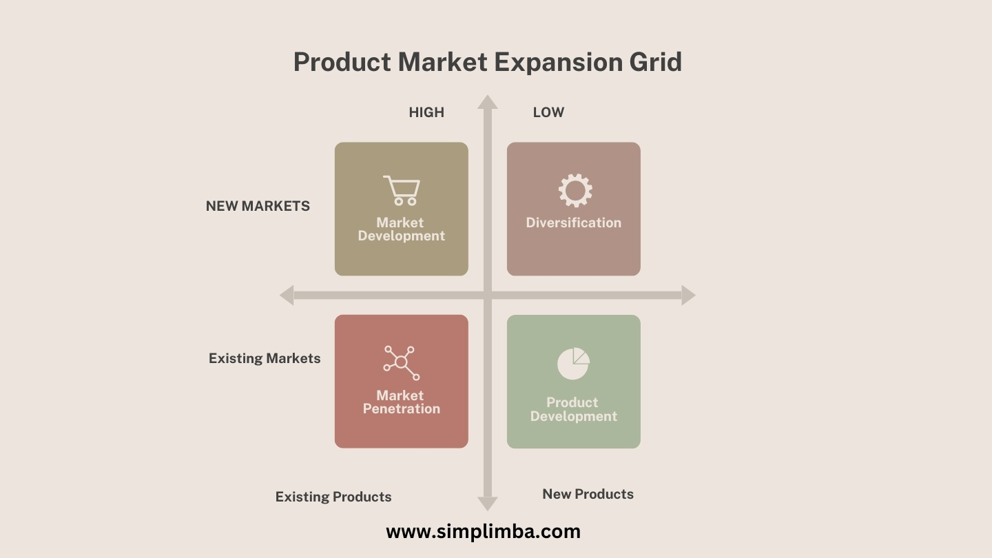
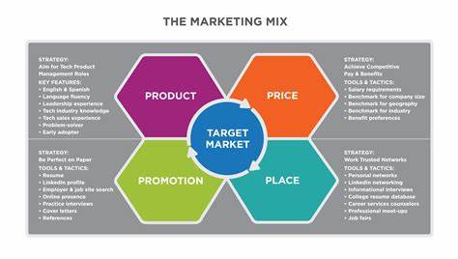
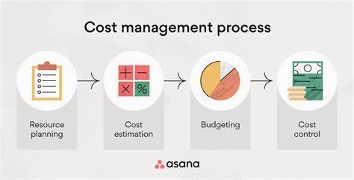
Recommendations
• Cost control and efficiency improvements
• Product mix optimization and strategic pricing
• Sales and marketing initiatives for market expansion

Slide 12

Conclusion
• ACME’s strong financial position and potential for growth
• Importance of cost management and CVP analysis for future strategies

